Slide 1
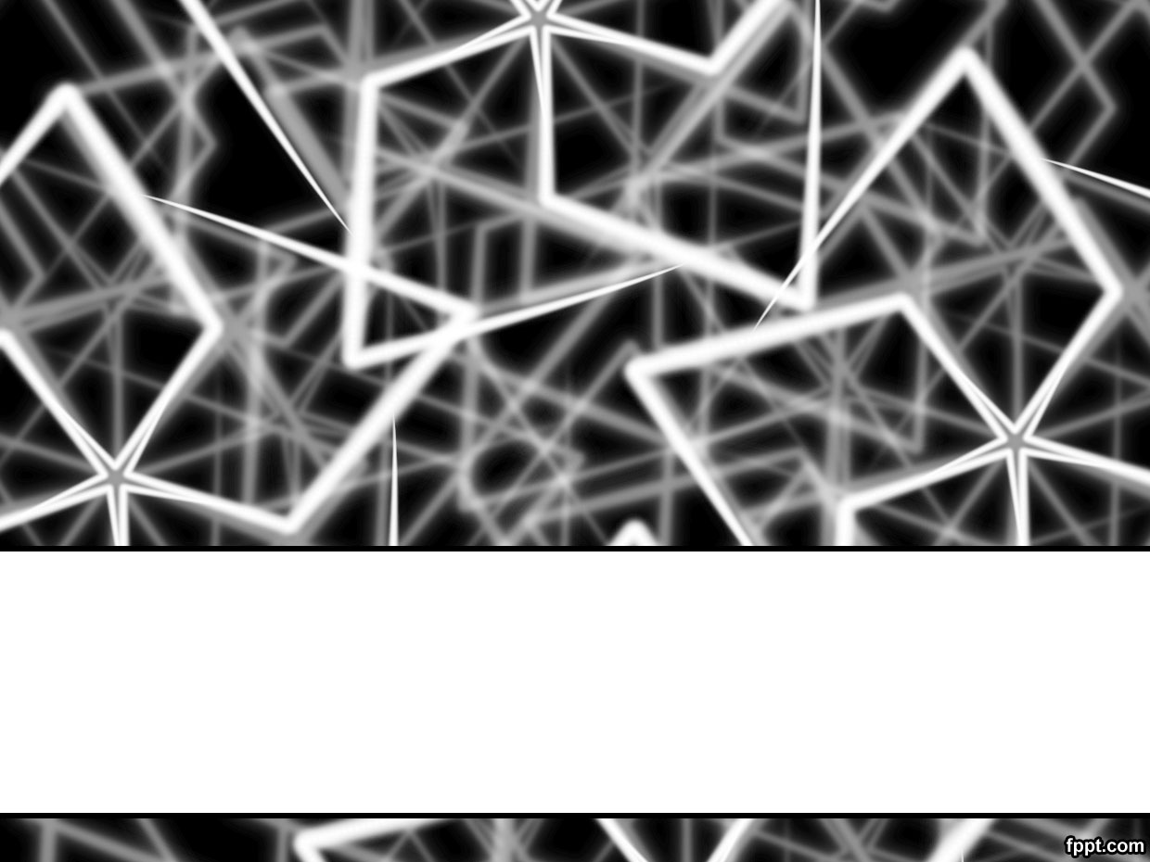
Lecture # 01
INTRODUCTION TO FORMAL METHODS

Slide 2
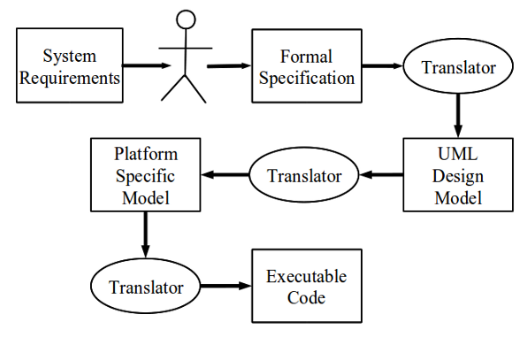
Software Engineering and Formal Methods
In computer science, specifically software engineering and hardware engineering, formal methods are a particular kind of mathematically based techniques for the
specification,
development and
verification
of software and hardware systems.
Formal methods can:
Be a foundation for describing complex systems
Be a foundation for reasoning about systems
Provide support for program development

Slide 3
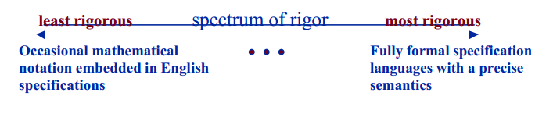
What are Formal Methods?
Techniques and tools based on mathematics and formal logic.
Can assume various forms and levels of rigor.
least rigorous spectrum of rigor most rigorous
Notes:
\

Slide 4
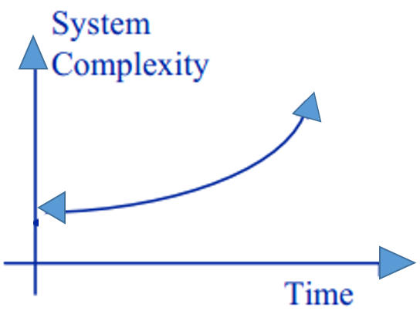
Why Consider Formal Methods?
Systems are increasingly dependent on software components
Complexity of systems with embedded software has increased rapidly
Maintaining reliability in software -intensive systems is very difficult
Notes:
A software-intensive system is any system where software contributes essential influences to the design, construction, deployment, and evolution of the system as a whole

Slide 5
Where are formal methods used?
Formal methods are usually used in the development of
safety,
business, and
mission critical software
where the cost of faults is high.
Notes:
There are three types of critical system:
Safety-critical systems A system whose failure may result in injury, loss of life or serious environmental damage. An example of a safety-critical system is a control system for a chemical manufacturing plant.
Mission-critical systems A system whose failure may result in the failure of some goal-directed activity. An example of a mission-critical system is a navigational system for a spacecraft.
Business-critical systems A system whose failure may result in very high costs for the business using that system. An example of a business-critical system is the customer accounting system in a bank.
Novel projects involve building something substantially new, where we can't just
take an existing system and make some obvious modifications. We need to compare
design alternatives, not just plunge ahead and implement the first idea that comes
along. We can't afford to build several versions of the whole system, so we have to
analyze models instead.
Projects are difficult when they tackle problems that are profound and deep, or
when they present a multitude of intricate details. Difficult projects need not be large;
a single page of code can present so many choices that trial-and-error guessing and
testing might never converge to a useful solution. We don't have to throw up our
hands and complain how incredibly complicated it is. We can use formal methods
to derive a solution and check that it is correct.
Many programming projects are neither novel, difficult, nor critical. In truth, many
of these are too tedious to be easy - let's call them routine. Experienced programmers
can adapt an adequate solution from their files, or their heads. Routine errors arise
from fatigue, haste, or simple carelessness, and can be detected by inspection of
the code against prose requirements - or implicit understandings that are not even
written down. Once the program is running, it is easy to determine if the results are
correct, and if they are not they can simply be discarded. In such routine jobs there
is no need to use formal methods.
A mission critical system is a system that is essential to the survival of a business or organization. When a mission critical system fails or is interrupted, business operations are significantly impacted.

Slide 6
Formal Specifications as a System Description
Clarify requirements and high-level design
Clarify hidden assumptions
Identify undocumented or unexpected assumptions
Expose flaws
Identify exceptions

Slide 7
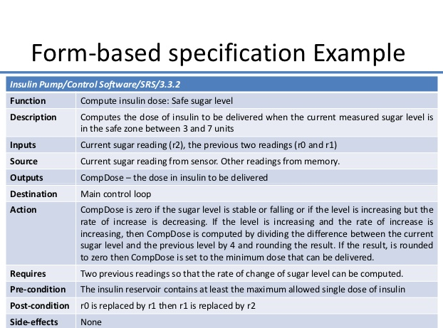
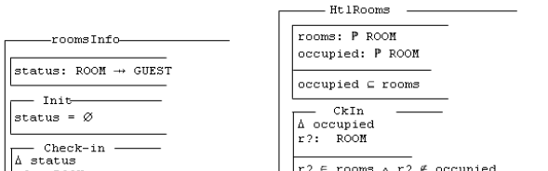
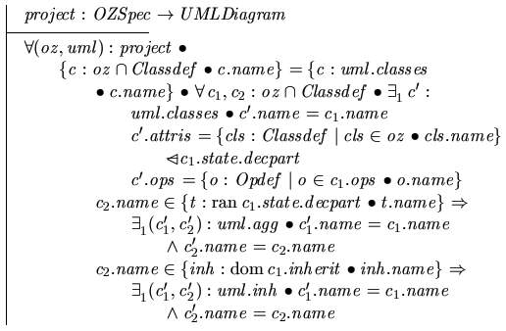
Simple vs Formal Specification
Simple Specification
Formal Specification

Slide 8
Benefits of Formal Specifications
Higher level of rigor enables a better understanding of the problem
Defects are uncovered that would likely go unnoticed with traditional specification methods
Identify defects earlier in life cycle
Can guarantee the absence of certain defects
Encourages an abstract view of system --focusing on what a proposed system should accomplish as opposed to how to accomplish it
Abstract formal view helps separate specification from design

Slide 9
Limitations to Formal Methods
Used as an addition to, not a replacement for, standard quality assurance methods
Formal methods are not a solution, but can increase confidence in a product’s reliability if applied with care and skill
Very useful for consistency checks, but can not assure completeness of a specification.

Slide 10
How can we use Formal Methods ?
We use formal methods in three essential activities:
Modeling
Model enable us to describe and predict program behavior.
Design
Design means organizing the internal structure of a program.
Verification
Verification means showing that our code will do what we intend.

Slide 11
Why Formal Methods are required?
History of software
Softwares encountered notorious bugs that were the cause of financial lose and deaths of many people.
Therac-25
Computerized radiation therapy machine called the Therac25. Killed many people, controller could not stop radiation due to software bug, later on the problem was fixed, after killing many people life
Uber Software Bug Catches “Cheater”
In France, a bug within the Uber app actually revealed a man’s affair with another woman to his wife. It ultimately led to a divorce and got Uber slapped with a $45 million lawsuit.
Toyota Car Accidents
A few years back, Toyota drivers began reporting a troubling issue: Their cars were accelerating without them actually touching the gas pedal. And after a few accidents, which were carefully investigated, it was discovered that software errors in the system were causing these dangerous issues.

Slide 12
Formal methods are not meant to
to show correctness" of entire systems
to replace testing entirely
to replace good design practices
One can't formally verify messy code with unclear specs.
to develop (program) a complete system

Slide 13
Formal methods are meant for
But ….
Formal proof can replace (infinitely) many test cases
Formal methods improve the quality of specs (even without formal verification)
Formal methods guarantee specific properties of system model

Slide 14
Myths of Formal Methods
J. A. Hall, “Seven myths of formal methods”.
Myth 1 (Hall): FMs guarantee perfect software and eliminate the need for testing.
Myth 2 (Hall): FMs are all about proving programs correct. (all about specification not program proving)
Myth 3 (Hall): FMs are only useful in safety-critical systems. (can help in any system)
Myth 4 (Hall): Application of FMs requires highly trained mathematicians.
Myth 5 (Hall): Applications of FMs increases development costs. (writing a formal specification decreases the cost of development)
Myth 6 (Hall): FMs are unacceptable to users. (help users understand what they are getting, The specification captures what the user wants before it is built.)
Myth 7 (Hall): FMs are not used on real large-scale systems. (The fact is that formal methods are used daily on industrial projects.)
Notes:
Formal methods should be
used wherever the cost of failure is high.
Systems whose cost of failure is high in-
clude those that are
critical in some way,
replicated many times,
fixed into hardware, or
dependent on quality for commercial
reasons.
FMs are unacceptable to users
How? The specification captures what
the user wants kfme it is built. But to real-
ize this benefit, you must make the specifi-
cation comprehensible to the user. There
are three ways to do this:
Paraphrase the specification in natural
language.
Demonstrate consequences of the
specification.
Animate the specification.
The first way is always essential. A mathe-
matical specification must be accompa-
nied by a natural-language description
that explains what the specification
means in real-world terms and why the
specification says what it does.
You must allocate time and resources
for the effort to write this accompanying
text. This effort is worthwhile, since our
experience has shown that documents
produced from a formal specification can
be more comprehensible, more accurate,
shorter, and more useful than informal
specificatio

Slide 15
Summary
Formal methods are used to ensure correctness and reliability of software systems
Formal methods are based on mathematical models.
Formal methods are difficult to apply but results are fruitful.
Formal methods does not mean we are programming a part of the system.
We are verifying the system correctness using formal methods.

Slide 16
Reading Assignment
J. P. Bowen & M. G. Hinchey, "Seven more myths of formal methods",

